Slide 1
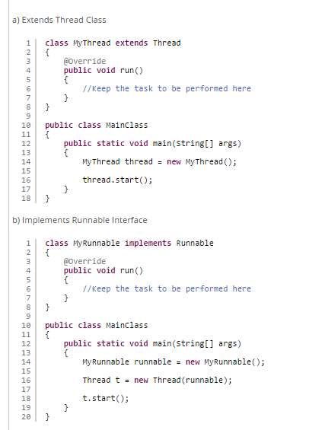
Runnable vs. thread

Slide 2
Runnable vs. thread
Difference between "implements Runnable" and "extends Thread" in Java
1) Multiple Inheritance Limitation
As you know, Java doesn’t support multiple inheritance. A class in java can extend only one class. If you extend Thread class, then your class will not be able to extend any other class. This will limit your class to thread behavior. If you implement Runnable interface, then you will have an option for your class to extend any other class and inherit behaviors from other class also.
2) Overhead Of Additional Methods
If you extend Thread class, all methods of Thread class will be inheriting to your class which you may not need. This will cause additional overhead. You can remove this overhead by implementing Runnable interface.
3) Logical Separation Of Task From The Runner
If you implement Runnable interface, it will separate actual task from the runner. Runnable interface represents only the task and you can pass this task to any type of runner, either a thread or any executors.
4) Best Object Oriented Design Practice
In object oriented programming, extending a class means modifying or improving the existing class. If you are not improving the class, then it is not a good practice to extend it. So, implementing Runnable will be the best object oriented design practice.

Slide 3
Runnable vs. thread
Difference between "implements Runnable" and "extends Thread" in Java
5) Loosely Coupled Vs. Tightly coupled
“Implements Runnable” makes your code loosely coupled. Because it separates the task from the runner. “Extends Thread” will make your code tightly coupled. Because, single class will act as both task container as well as runner.
6) Reusability
Implementing Runnable improves the reusability of your code. Because, Runnable contains only the task and you can use it wherever and whenever you want.
7) Specialization Vs. Generalization
“Extends Thread” gives more specialized code. Because, it defines the thread specific task. Where as “Implements Runnable” gives more generalized version of the task applicable to many threads.
8) Maintenance
“Implements Runnable” will make your code easily maintainable as it separates the task from the runner. If you want to modify the task at any time, you can do so easily without disturbing the runner.

Slide 4
Runnable vs. thread
implements Runnable | extends Thread
You can extend any other class. | You can’t extend any other class.
No overhead of additional methods. | Overhead of additional methods from Thread class.
Separates the task from the runner. | Doesn’t separate the task from the runner.
Best object oriented programming practice. | Not a good object oriented programming practice.
Loosely coupled. | Tightly coupled.
Improves the reusability of the code. | Doesn’t improve the reusability of the code.
More generalized task. | Thread specific task.
Maintenance of the code will be easy. | Maintenance of the code will be time consuming.
Conclusion :
From the above all findings, it is clear that “Implements Runnable” is the preferred method to create the threads in java.

